Slide 1

Thank you for downloading!
Hope it helps and inspires your next presentation!
In case the embedded fonts don’t work, download and install these fonts:
NHL Ducks: https://www.dafont.com/nhl-ducks.font?text=Karina
Archivo: https://fonts.google.com/specimen/Archivo
Here are the videos I’ve used:
Videos: https://youtube.com/playlist?list=PLlUDdVysmOVl-WRaYhIjIGNWzrq3EGTl-

Slide 2
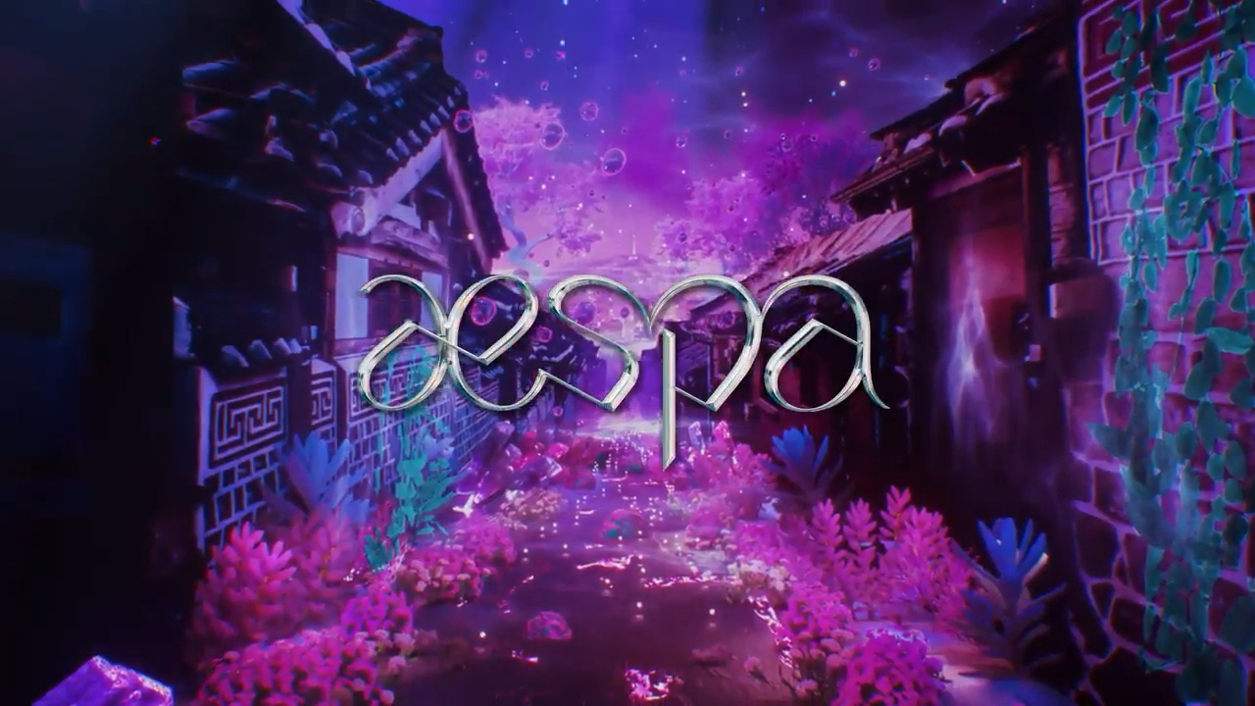

Loading data...

Slide 3
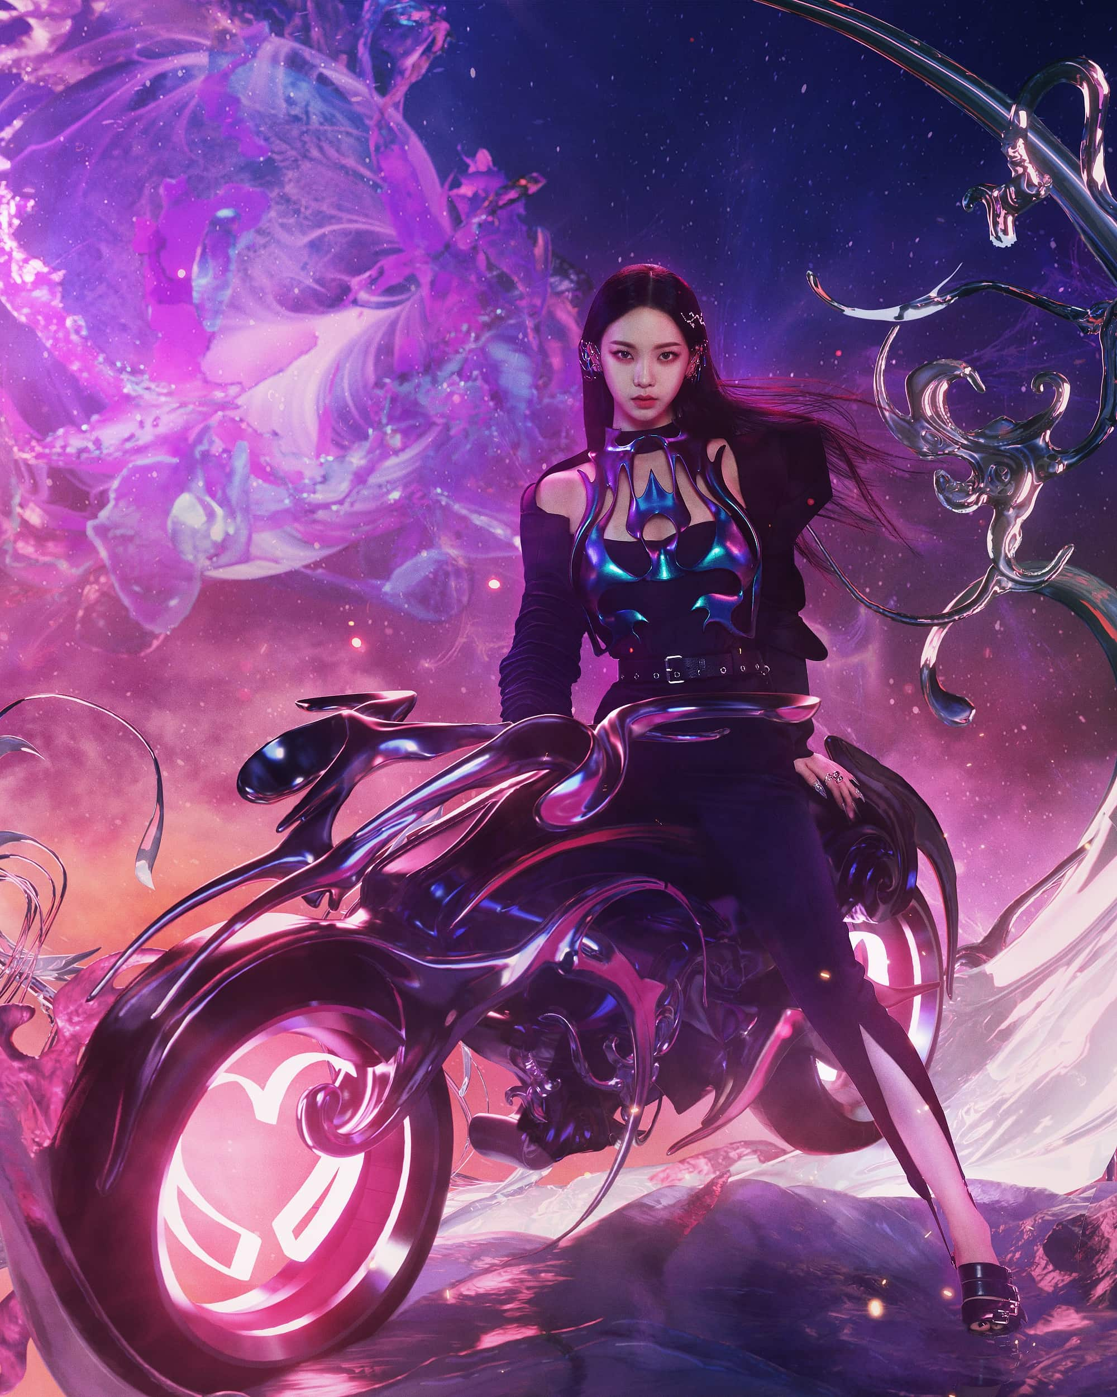
Play
train
Ae gallery
Shop
Leaderboard
profile
Option
Exit game

Slide 4
Play
train
Ae gaallery
Shop
Leaderboard
profile
Option
Exit game

Slide 5
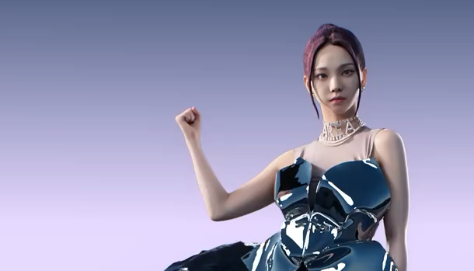

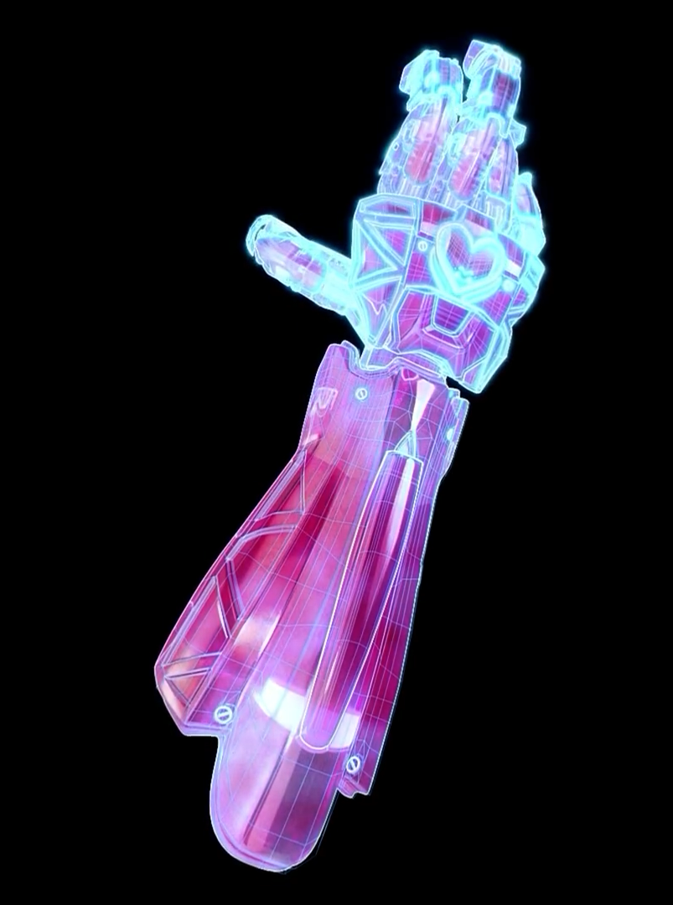
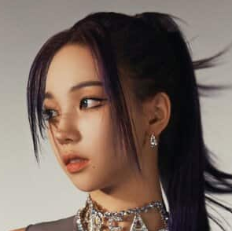

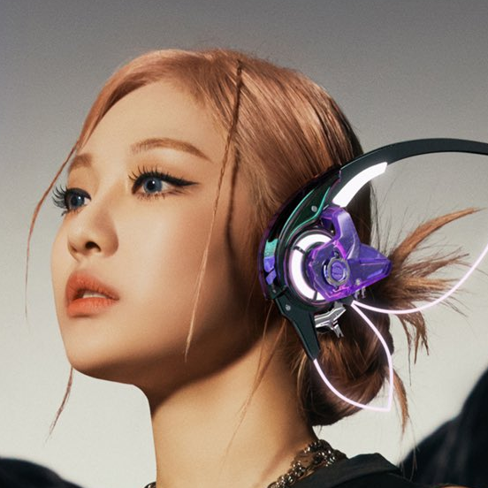
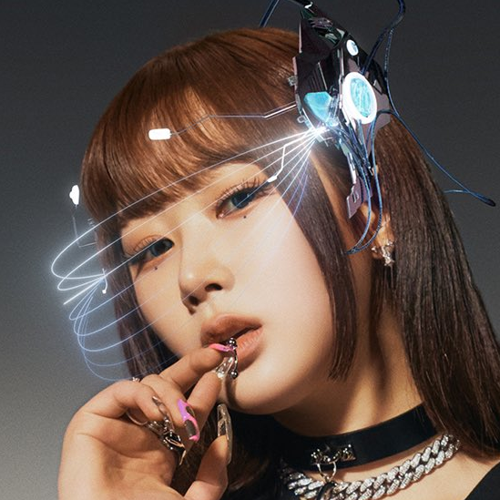
KARINA
ROCKET PUNCHER
Tank
Tanks able to withstand enemy assaults. Kitted with shields, crowd-control devices, and high health pools, tanks excel at holding or pushing objectives with allies.
Damage
Toughness
Speed
Utility
Select

Slide 6
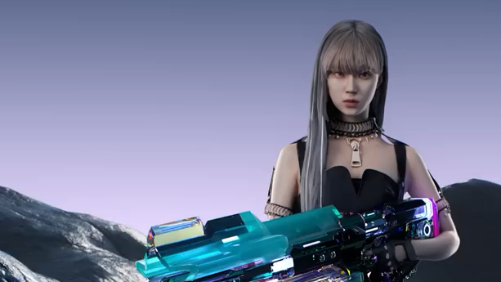


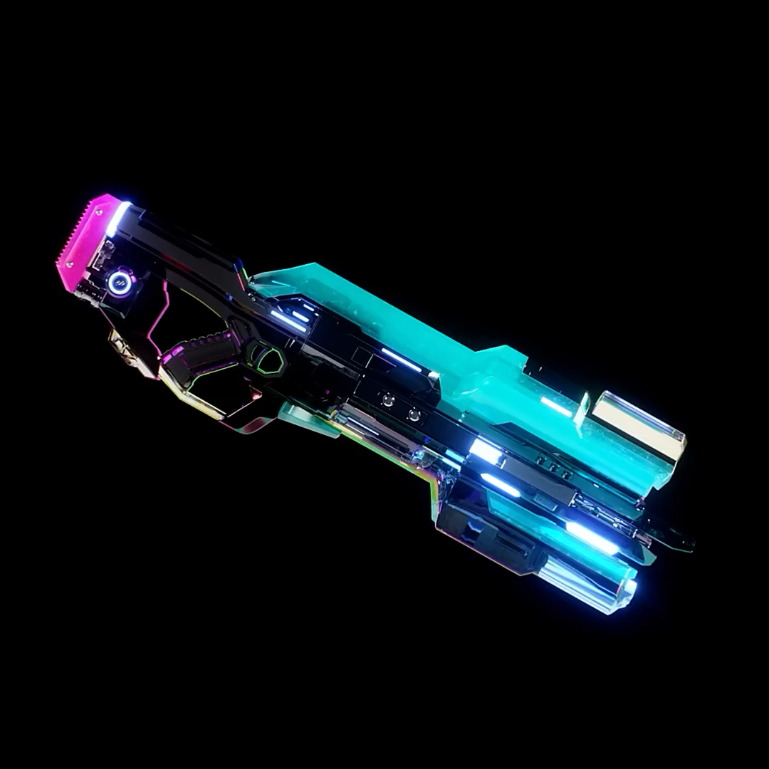
WINTER
ARMAMENTER
Support
The backbone of the squad, the Support staff are the buffers, builders, and healers. Boost your team's skills, buff their speed, or reduce the damage they can take.
Damage
Toughness
Speed
Utility
Select

Slide 7
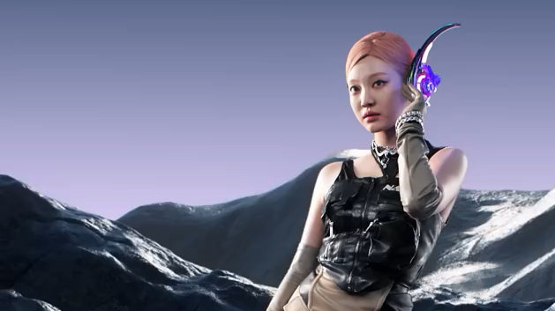

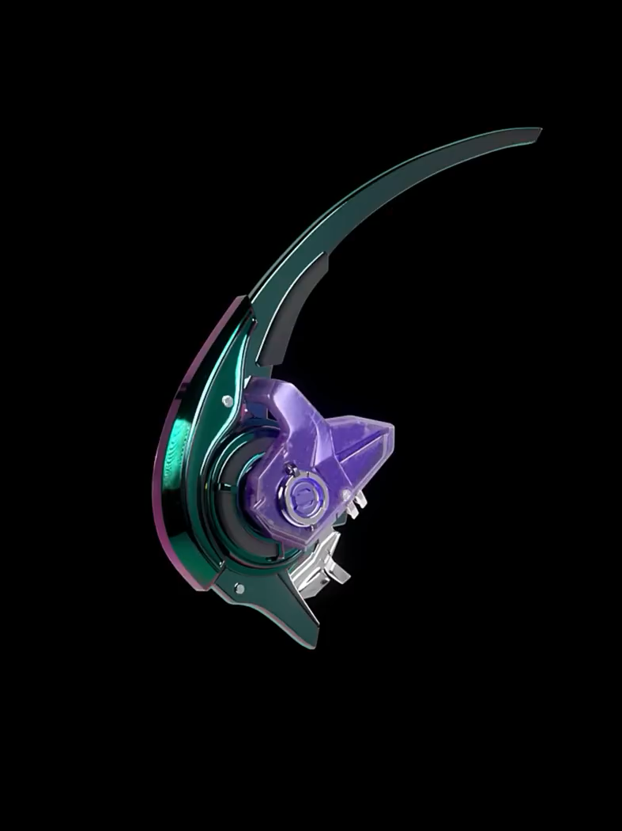
E.D. HACKER
NINGNING
Support
The backbone of the squad, the Support staff are the buffers, builders, and healers. Boost your team's skills, buff their speed, or reduce the damage they can take.
Damage
Toughness
Speed
Utility
Select

Slide 8
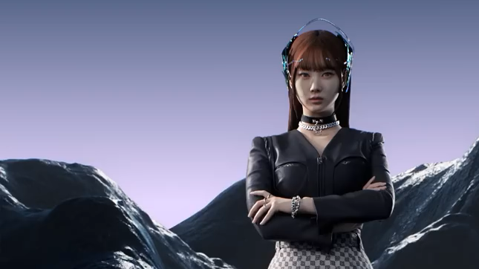

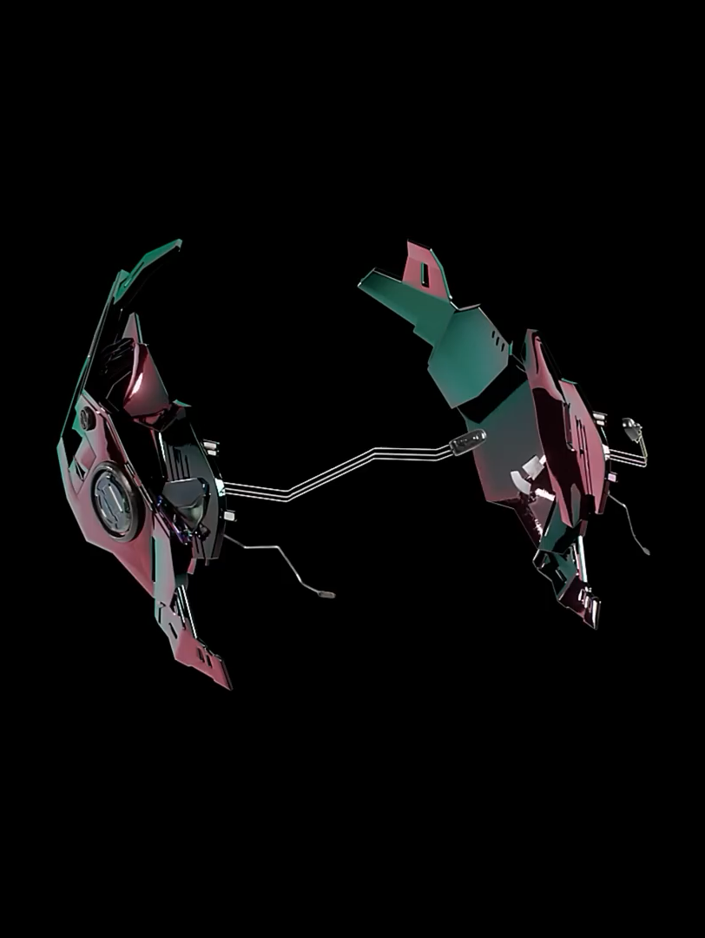
Giselle
XENOGLOSSY
Support
The backbone of the squad, the Support staff are the buffers, builders, and healers. Boost your team's skills, buff their speed, or reduce the damage they can take.
Damage
Toughness
Speed
Utility
Select

Slide 9

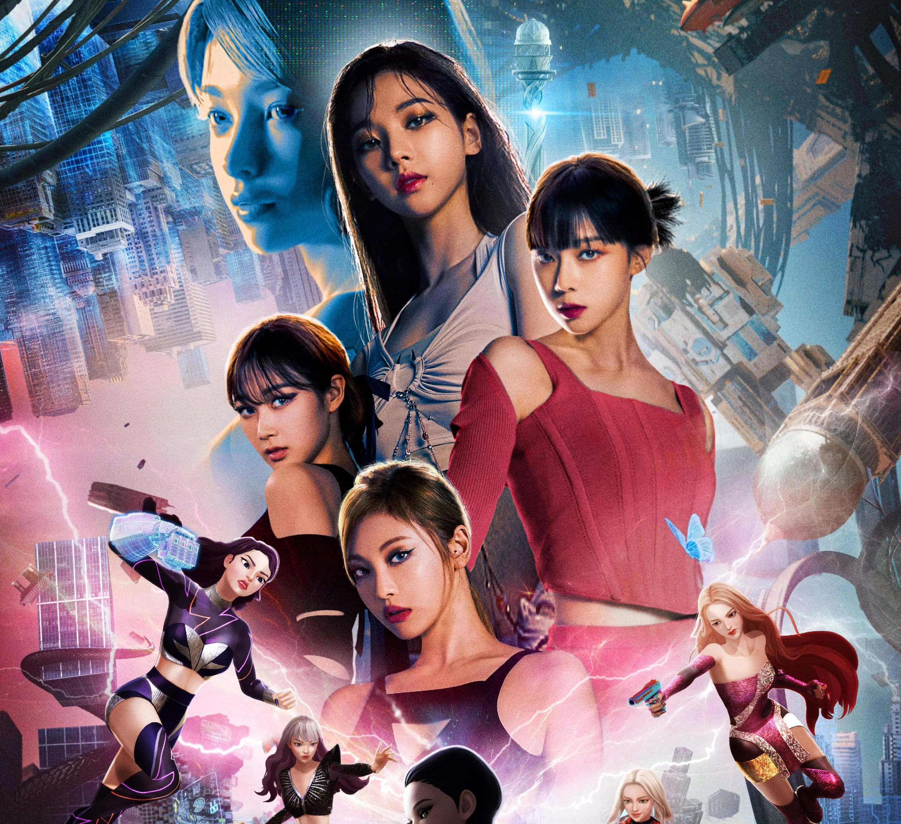
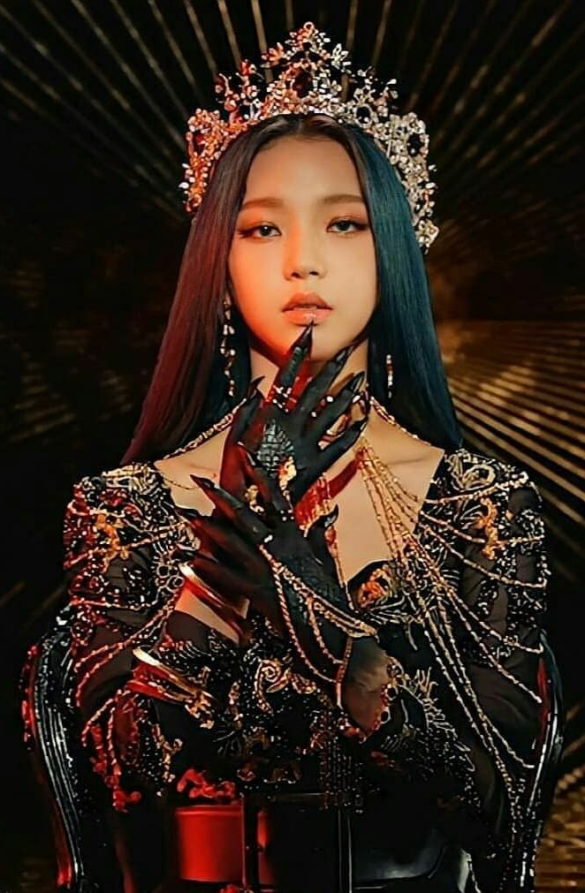
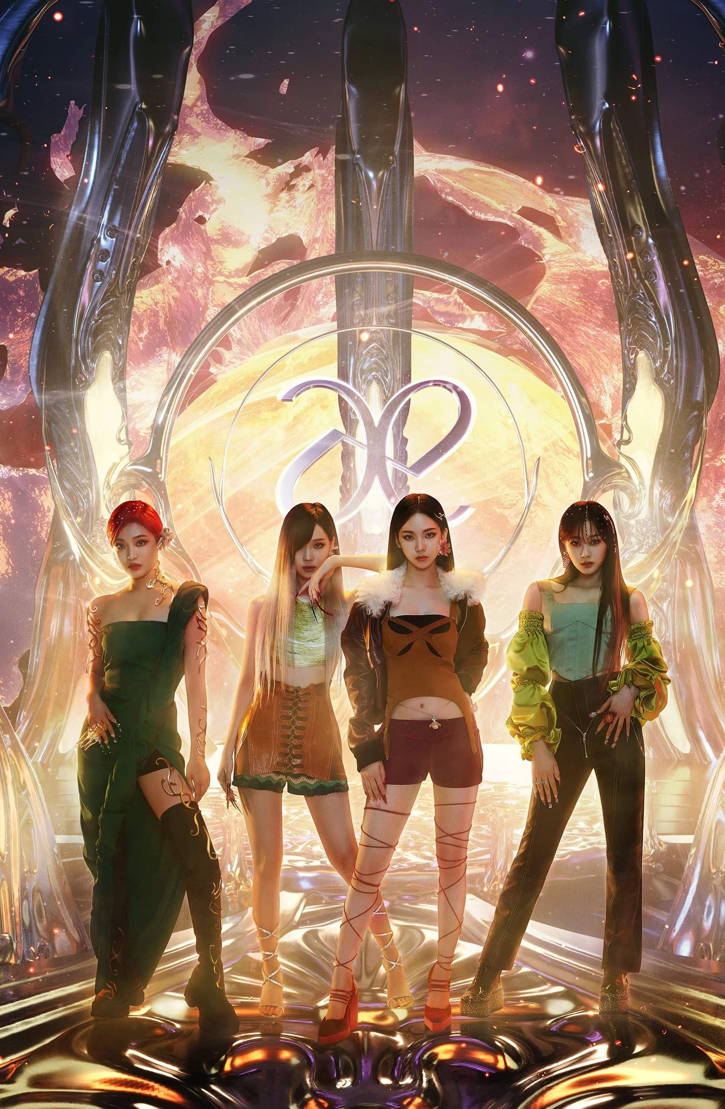
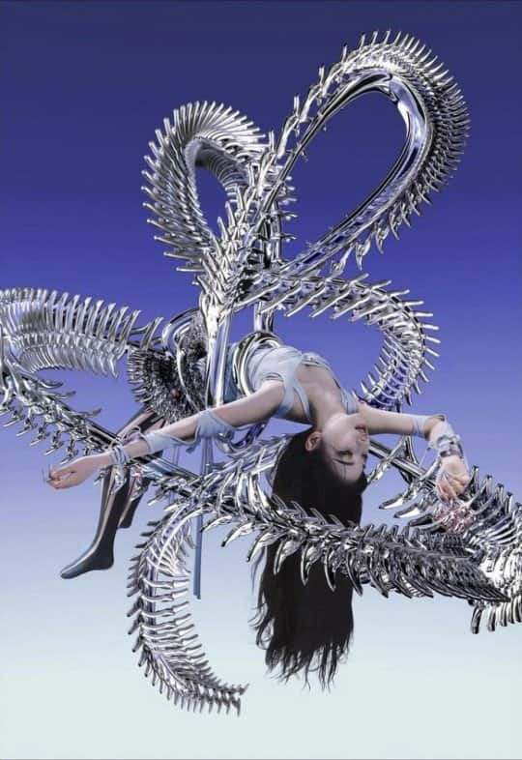
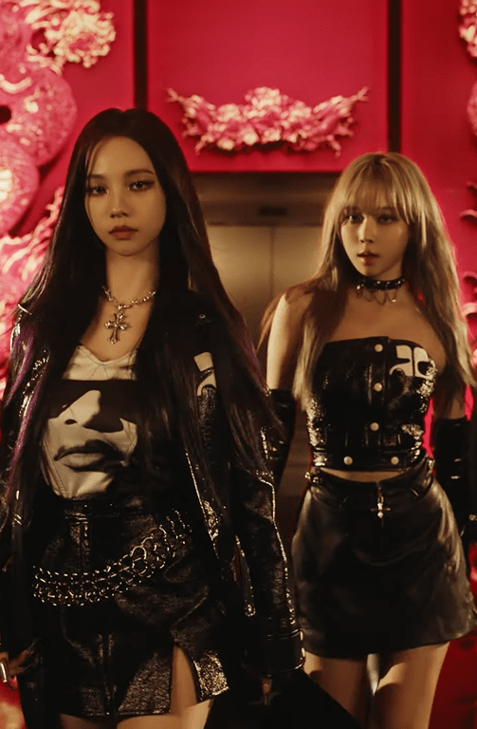
Featured events
All events
SMCU Season 1
A phenomenon occurred where the connection of both the human and æs got forcibly disconnected. It created a SYNKOUT all over the world.
Black Mamba
aespa defeats the Black Mamba with the use of their individual skills.
Next level
aespa go on their way to discover what’s blocking the SYNK.
SAVAGE
aespa defeats the Black Mamba with the use of their individual skills.
Girls
aespa enters a new chapter as they’ve finally defeated their arch-nemesis

Slide 10
Featured events
All events
SMCU Season 1
A phenomenon occurred where the connection of both the human and æs got forcibly disconnected. It created a SYNKOUT all over the world.
Black Mamba
aespa defeats the Black Mamba with the use of their individual skills.
Next level
aespa go on their way to discover what’s blocking the SYNK.
SAVAGE
aespa defeats the Black Mamba with the use of their individual skills.
Girls
aespa enters a new chapter as they’ve finally defeated their arch-nemesis
Notes:
The mission was simple: destroy Black Mamba and rescue their ae.

